Slide 1
Supplemental Data Legends
Supplemental Figure S1: Representative full-length gel of N-MVEC lysate probed for Mfn-2 (80 kD).
Supplemental Figure S2. Effect of GSKA on mitochondrial morphology. A) Representative mitochondrial network images of N- and SuHx-MVECs with and without GSKA treatment. B-C) Length distribution curves for N- and SuHx-MVEC mitochondria with and without GSKA treatment. * denotes significant difference from N-MVEC control, n=5 per group.
Supplemental Figure S3: Length distribution curves for SuHx-MVECs with and without cyclosporine A (CsA) treatment.
Supplementary Table 1. Table showing raw oxygen consumption rate (OCR) and extracellular acidification rate (ECAR) values in untreated, MQ-treated and HC-treated N- and SuHx-MVEC.
Supplementary Table 2. Table showing LC/MS parameters used to obtain glycolysis and TCA metabolite levels for N- and SuHx-MVECs.

Slide 2
Mfn-2
Supplemental Figure S1: Representative full-length gel of N-MVEC lysate probed for Mfn-2 (80 kD).

Slide 3

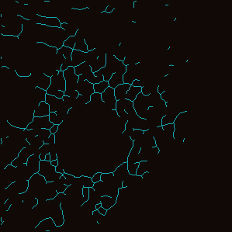
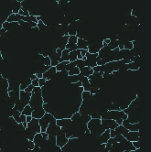
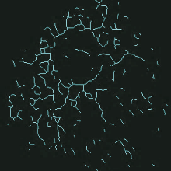
A
SuHx
Normoxic
- GSKA
+ GSKA
B
C
Supplemental Figure S2. Effect of GSKA on mitochondrial morphology. A) Representative mitochondrial network images of N- and SuHx-MVECs with and without GSKA treatment. B-C) Length distribution curves for N- and SuHx-MVEC mitochondria with and without GSKA treatment. * denotes significant difference from N-MVEC control, n=5 per group.

Slide 4
Supplementary Figure S3: Length distribution curves for SuHx-MVECs with and without cyclosporine A (CsA) treatment.

Slide 5
 | Basal Respiration (pmol/min/Norm unit)
 | Normoxic |  |  | SuHx
 | Ctl | MQ | HC | Ctl | MQ | HC
Lot 1 | 39.653 | 35.392 | 48.571 | 44.694 | 63.231 | 24.527
Lot 2 | 41.471 | 47.218 | 36.356 | 33.133 | 66.79 | 21.248
Lot 3 | 39.469 | 71.627 | 42.844 | 17.479 | 45.335 | 29.779
Lot 4 | 42.352 | 71.627 | 40.949 | 18.022 | 81.127 | 5.4729
Lot 5 | 80.645 | 64.105 | 23.521 | 20.337 | 89.197 | 9.3169
 | Extracellular acidification rate (mPh/min/Norm Unit)
Lot 1 | 46.626 | 45.259 | 31.813 | 335.33 | 22.701 | 172.226
Lot 2 | 41.92 | 33.022 | 40.225 | 371.54 | 29.286 | 151.96
Lot 3 | 49.78 | 37.882 | 18.16 | 193.83 | 13.910 | 135.2
Lot 4 | 7.1182 | 4.394
Table 1: Raw values for basal respiration and Extracellular acidification rate in N- and SuHx-MVECs. Each row of N- and SuHx-MVEC data represents a paired set of samples run at the same time. For part of Lot 4 and Lot 5, pH sensor calibration was unsuccessful, and thus these ECAR measurements were not used.Ctl: Untreated; MQ: MitoQ; HC: HC-067047
SupplementaryTable 1

Slide 6
Supplementary Table 2: LC/MS parameters
Parameter | Value
Run temperature | 4 degrees
Separation strategy | RP chromatography with aqueous mobile phase of MS-grade water with 0.1% formic acid, and organic phase of 98% acetonitrile with 0.1% formic acid.
Column | Discovery HS F5 HPLC (3 µm particle size, L x I.D. = 15cm x 2.1mm) – 35 deg
Injection volume | 2 µL
Total run time | 50 minutes
Flow rate gradient | 0-27 mins: 0.15 ml/min 27-47mins: 0.3 ml/min 47-50mins: 0.15
Mobile Phase Gradient | 100% aqueous (6 mins) 70% aqueous (6-15mins) 50% aqueous (15-26mins) 0% aqueous (26-35 mins) 100% aqueous (35mins-end)
QQQ nebulizer pressure | 30 psi
QQQ gas flow | 17 L/min
QQQ gas temperature | 210 ° C
Sheath Gas Flow | 12 L/min
Sheath gas heater | 350 ° C
ESI Ion source Voltage Parameters | Cap Voltage: 4000V, Charging: 1500V, Fragmentor: 380V, cell accelerator: 3 V
QQQ ion funnel | Positive low-pressure RF: 60V; positive high-pressure RF: 130V; negative low-pressure RF: 40V; negative, high-pressure RF: 100V.

